Slide 1
A Study Of The Book Of Revelation
October 17, 2021

Slide 2
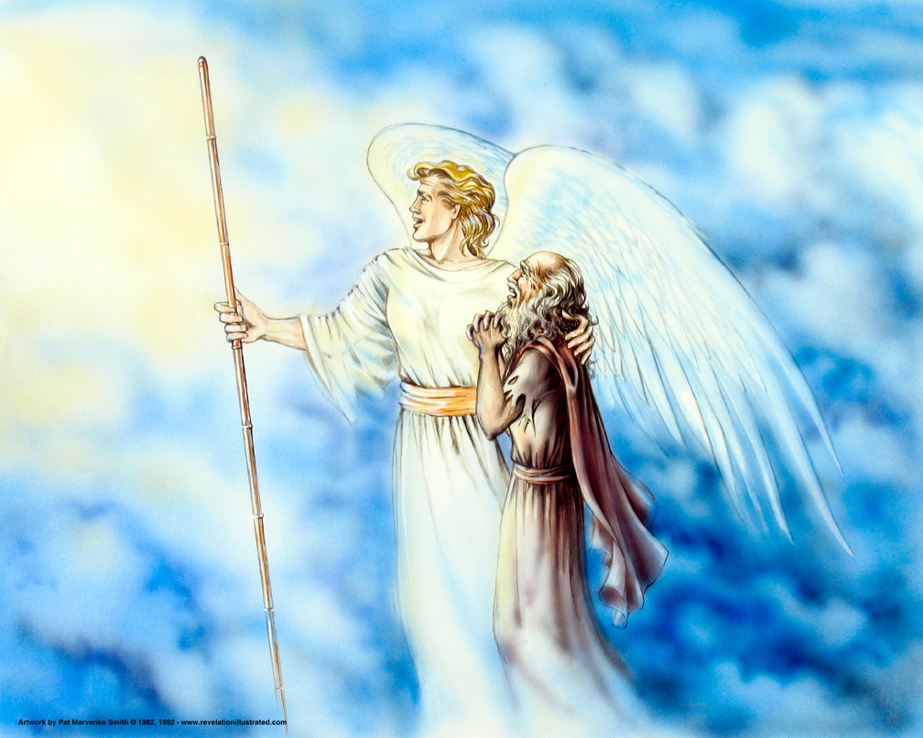
The Book of Revelation: Chapter 21
Revelation 21
The New Jerusalem!

Slide 3
The New Jerusalem
Revelation 21
The glory described in Isaiah has been realized in the church on earth since the days of Pentecost. Isaiah 65:16, 17, 25 – These are fulfilled in the reign of Christ.
The glory described in Revelation 21-22 will be realized when death is no more.
2 Peter 3:7-13; Revelation 21 – This new order is beyond the Judgment.
The devil is defeated. This new heaven and earth will be clean and undefiled for the permanent dwelling place of those who have overcome the wiles of the devil during their lifetime.

Slide 4

Revelation 21:9 The Bride, A Marriage That Will Never Fail
Revelation 21
“And there came one of the seven angels who had the seven bowls, who were laden with the seven last plagues; and he spake with me, saying, Come hither, I will show thee the bride, the wife of the Lamb.”
Revelation 19:7-8
cf. Revelation 17:1

Slide 5
Revelation 21:10 The City: Walls That Will Never Fall
Revelation 21
“And he carried me away in the Spirit to a mountain great and high, and showed me the holy city Jerusalem, coming down out of heaven from God,”

Slide 6
John’s Vision
Revelation 21
One of the seven angels, who has the seven vials of the last plagues, talked with John
He is taken “in the Spirit” up to a high mountain
From that vantage point he is allowed to survey the holy city.
He is going to see a detailed vision of the “Lamb’s bride” (Ephesians 5:22-33)
It is a city descending from the presence of God.
This in its glorified and heavenly form

Slide 7
Revelation 21:11
Revelation 21
“having the glory of God: her light was like unto a stone most precious, as it were a jasper stone, clear as crystal:”

Slide 8
Revelation 21:12
Revelation 21
“having a wall great and high; having twelve gates, and at the gates twelve angels; and names written thereon, which are (the names) of the twelve tribes of the children of Israel:”

Slide 9
Description of the City
Revelation 21
Having the “glory of God”
Light was likened unto a “jasper stone” (4:3)
Clear as crystal
Most scholars conclude this is like a diamond
The beauty and grandeur of the city reflect the glory of God
Brilliant light is pure and perfect (22:5)

Slide 10
Description of the City
Revelation 21
Wall was great and high
Built as protection for ancient cities – thick high wall
12 gates – 12 angels at the gates
People of God – only those who maintained garments may enter. Abundant entrance. 2 Peter 1:11
Names written on the gates
Names of the 12 tribes of Israel. (cf. Hebrews 9:15; 11:10, 13-16).
Faithful of OT times in the heavenly city.
Reuben, Simeon, Levi, Judah, Zebulun, Issachar, Dan, Gad, Asher, Naphtali, Joseph, Benjamin

Slide 11
Revelation 21:13
Revelation 21
“on the east were three gates; and on the north three gates; and on the south three gates; and on the west three gates.”

Slide 12
Revelation 21:14
Revelation 21
“And the wall of the city had twelve foundations, and on them twelve names of the twelve apostles of the Lamb.”

Slide 13
Entrance of the City
Revelation 21
Entrance from the city was available from four directions.
3 east – 3 north – 3 south – 3 west
People from every kindred, tongue, people, and nation. (Revelation 5:9; 7:9)
Gates of the ancient cities were closed at night for protection

Slide 14
Entrance of the City
Revelation 21
12 Gates of the heavenly city which are never closed – abundant entrance! 2 Peter 1:11
The gates will not need to be shut because no enemies exist to invade the city.
They have all been cast into the lake of fire (19:20; 20:10, 15; 21:8).

Slide 15
Foundations of the City
Revelation 21
Wall of the city had 12 foundations
One foundation for every gate
Names of the 12 apostles of the Lamb
Those of the NT era who will enter the city have also walked by faith
Built by the gospel that had been preached
Peter, Andrew, James, John, Philip, Bartholomew, Thomas, Matthew, James the son of Alphaeus, Thaddaeus, Simon the Canaanite, Judas Iscariot
John would have seen his own name!

Slide 16
Revelation 21:15
Revelation 21
“And he that spake with me had for a measure a golden reed to measure the city, and the gates thereof, and the wall thereof.”

Slide 17
Revelation 21:16
Revelation 21
“And the city lieth foursquare, and the length thereof is as great as the breadth: and he measured the city with the reed, twelve thousand furlongs: the length and the breadth and the height thereof are equal.”

Slide 18
Revelation 21:17
Revelation 21
“And he measured the wall thereof, a hundred and forty and four cubits, (according to) the measure of a man, that is, of an angel.”

Slide 19
Measuring the City
Revelation 21
Golden reed (or rod) was used to measure
Ensure “perfection” of the city (in its provisions)
The gates (means of entrance)
The walls (security of protection)
Measurement was a “perfect cube”
Its length, breadth, height was 12,000 furlongs (1,500 miles)
12 = people of God 1,000 x ten = complete full number
Literal? NO! Could not fit into Palestine!

Slide 20
Measuring the City
Revelation 21
Literal measurement? (1 Kings 6:20)
Its staggering dimension is simply to depict the fact that heaven will be so enormous it will adequately contain all the saved!
Wall measures 144 cubits (thickness?) 12x12
According to the “measure of a man”
Indicates, in an apocalyptic way, full security for the people who dwell within its confines. Ultimate “holy place”

